Slide 1


The Writing Process
Notes:
Discuss the following questions:
1) How many of you have used the writing process before?
2) What is the writing process?
3) Why is it important to use the writing process?

Slide 2
The Five
Steps:
Notes:
What are the steps of the writing process?

Slide 3


Slide 4
Prewriting
Drafting
Revision
Editing
Publishing

Slide 5

Prewriting
Notes:
Discuss:
1) What does prewriting mean?
2) What are some strategies we can use for prewriting?
-journal writing
-mind map
-internet or library research
-create an outline or flowchart

Slide 6
Prewriting
choose a topic
gather
material
Plan basic structure
choose a format
Notes:
Discuss:
1) What does prewriting mean?
2) What are some strategies we can use for prewriting?
-journal writing
-mind map
-internet or library research
-create an outline or flowchart

Slide 7

Drafting
Notes:
Discuss:
1) What is drafting?
2) What does it mean to write a “rough draught” or “first draught?”
3) What is hard about getting started? What can you do when you have “writer’s block?”

Slide 8
Drafting
Get your ideas on paper!
Use sentences and paragraphs.
Follow the basic structure of the genre you have chosen.
Notes:
Discuss:
1) What is drafting?
2) What does it mean to write a “rough draught” or “first draught?”
3) What is hard about getting started? What can you do when you have “writer’s block?”

Slide 9
Drafting
Don’t worry about getting it perfect!
Notes:
Discuss:
What is drafting?
What does it mean to write a “rough draught” or “first draught?”
What is hard about getting started? What can you do when you have “writer’s block?”

Slide 10
Drafting
You can fix it later!
Notes:
Discuss:
What is drafting?
What does it mean to write a “rough draught” or “first draught?”
What is hard about getting started? What can you do when you have “writer’s block?”

Slide 11
After you finish your first draft, you should get someone else’s perception of your work.

Slide 12
Find a couple of people to read your work—or better yet—read it aloud to them.

Slide 13
Ask the following questions, and tell them that you would appreciate their honesty:

Slide 14

Notes:
Elaborate on Questions. Discuss how getting feedback can help writers improve their work:
Give praise. What specifically is good about the piece (Three things)
What can the author do to clarify the piece?
What questions do you have that the reader needs to answer in the revision?
What specifically would you do to improve the piece? (Two to three things?\)

Slide 15
What do you like about my piece?
What is unclear?
What questions do you have?
What would you do to improve it?
Notes:
Elaborate on Questions. Discuss how getting feedback can help writers improve their work:
Give praise. What specifically is good about the piece (Three things)
What can the author do to clarify the piece?
What questions do you have that the reader needs to answer in the revision?
What specifically would you do to improve the piece? (Two to three things?\)

Slide 16

revision
Notes:
Discuss:
What is the difference between revising and editing?
What are some things we can do to revise our pieces?
Why is it important to revise your work?

Slide 17
revision
Add details, examples and illustrations to strengthen and clarify.
Rewrite awkward or unclear sentences or paragraphs.
Cut any words, sentences or paragraphs that are off-topic, distracting or unnecessary.
Notes:
Discuss:
What is the difference between revising and editing?
What are some things we can do to revise our pieces?
Why is it important to revise your work?

Slide 18
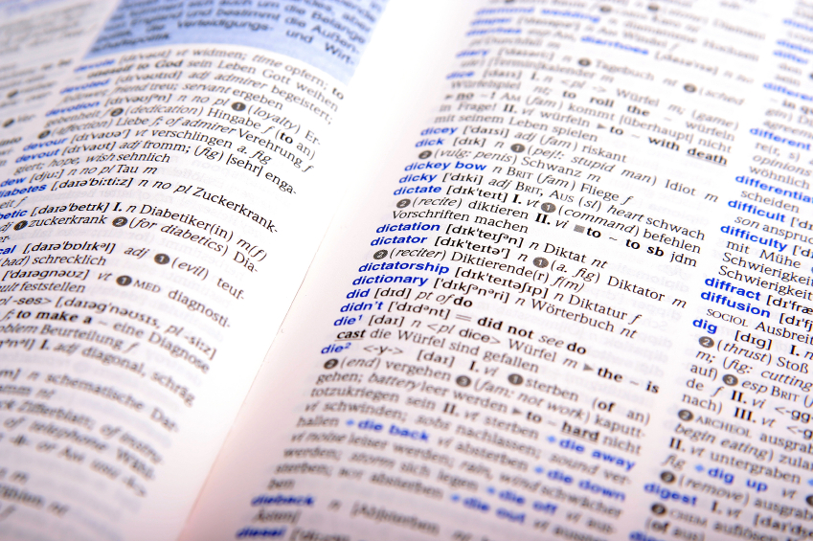
editing
Notes:
Discuss:
Why is it important to edit your work?
What are some tools or strategies that can help you edit effectively?
How have computers made editing easier?

Slide 19
editing
Correct:
Spelling
Grammar
Punctuation
Style
Notes:
Discuss:
Why is it important to edit your work?
What are some tools or strategies that can help you edit effectively?
How have computers made editing easier?

Slide 20

Turn it in!
Post it to a blog!
Submit it to a publication!
Any other ideas?
publishing
Notes:
Discuss:
Why is publication an important step?
Where are some places that students can publish their work?

Slide 21
Presentation
by J.T. Draper.

Slide 22
All images courtesy of Microsoft Clip Art.

